Slide 1
UAV Landing Gear Extract and Extend System with MTOW 7 kilograms
Compiled By :
Didit Widiyanto (Expert)
Damora Rhakasywi (Competitor)
Amat Chaeroni (Competitor)

Slide 2
Introduction
This presentation introduces a military-specification UAV designed for intelligence and reconnaissance operations—capable of low-flying for tactical surveillance, conducting short take-off and landing (STOL) approaches in confined terrain, and carrying advanced sensor loads for real-time data collection. With a modular and environmentally resilient platform, future developments explore amphibious capabilities for land-sea operations. This solution enhances situational awareness, rapid response, and mission flexibility in the modern theater of operations.
This presentation highlights a military-specification UAV with high stealth capabilities for covert operations, equipped with an intelligent navigation system capable of auto-detecting and avoiding obstacles independently. This UAV is controlled by a custom-developed RTOS (Real Time Operating System), enabling high-precision response to dynamic conditions on the ground, including real-time control of the retract and extend landing gear. This technology ensures optimal performance, high reliability, and maximum efficiency in various modern tactical missions.

Slide 3
Roadmap
Year 1 – Initial Research and Design
Focus – STOL Aerodynamic, Amphibi Opsional, Stealth, Navigasi Cerdas, Landing Gear RTOS
Activity:
Aerodynamic design studies & STOL simulations
Stealth & Materials Research
Obstacle Detection and Avoidance Design
Initial Development Design for RTOS Landing Gear
(STOL & amphibious Study, stealth research, navigation design, early landing gear development)

Slide 4
Roadmap
Year 2 – Integration and Laboratory Testing
Focus: Scale Prototype, Stealth Technology Integration, RTOS (Real Time Operating System), Obstacle Avoidance
Activities:
Wind tunnel testing of scaled prototypes, Stealth integration & RCS testing, RTOS implementation & intelligent navigation.
Preparation of full-scale prototypes (Scaled prototype tests, stealth integration, RTOS & navigation, full-scale prep

Slide 5
Roadmap
Year 3 – Production & Field Testing
Focus: Full-Scale Prototype, STOL, Amphibious, Flight Test
Activities:
Full-scale prototype manufacturing
STOL testing & amphibious validation (optional)
Flight control, stealth & autonomous navigation testing
RTOS & avionics calibration
Full-scale production, STOL & amphibious test, flight systems, RTOS calibration

Slide 6
What has been done (Our Research in Jakarta Indonesia) :
Stealth technology will use meta-materials with the basic principle being a series of RLC resonators with auto tuning using Artificial Intelligence based adjusters.

Slide 7
What has been done (Our Research in Jakarta Indonesia) :
Navigation will be implemented in several modes, including takeoff, landing approach, as well as artificial intelligence-based obstacle detection and avoidance. Flight mode will utilize a deterministic Finite State Machine (FSM) approach as a higher-layer control, while AI will be used for solutions such as obstacle detection and avoidance.

Slide 8
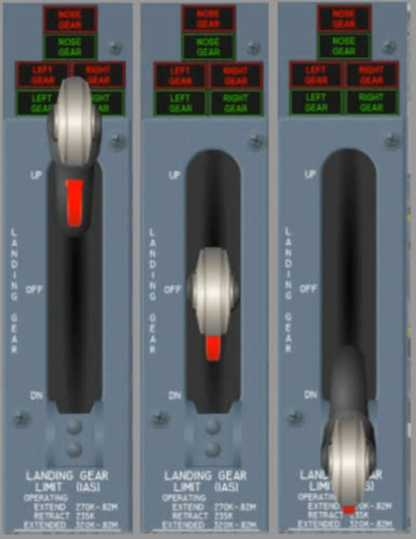
Interface system retract and extend and three landing gear lever positions: up or retract (left image), off (middle image) and down (right image)
The lever is required to be in the off position so that if the button is accidentally touched, the gear will not immediately extend out or retract into. Off is the system's in state of remember position to the previous state (no status changes).

Slide 9
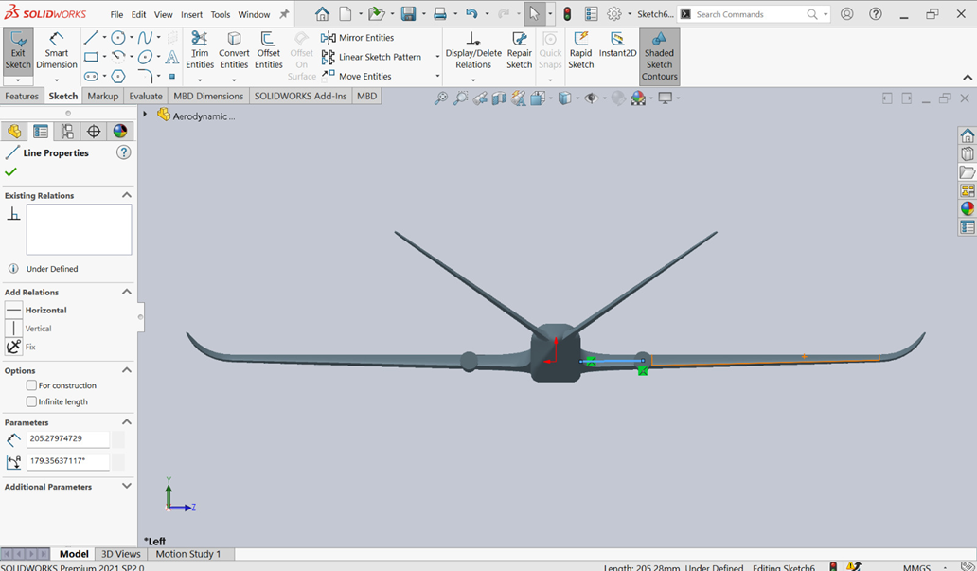
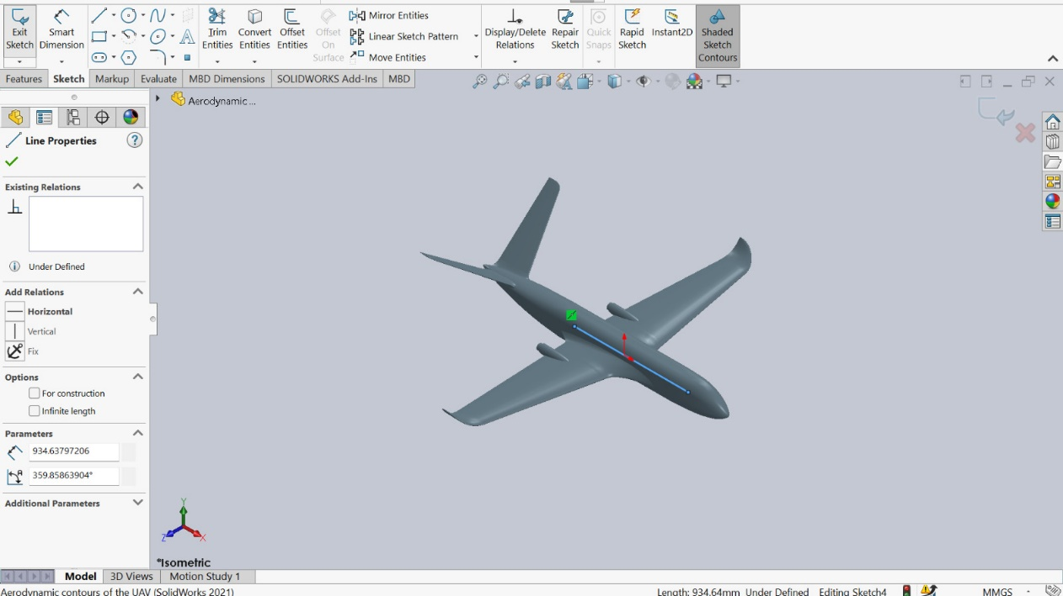
Spec of UAS
MTOW = 7 kg
Landing Speed = 12 m/s
Max Speed = 35 m/s
Landing AoA = 10 deg

Slide 10
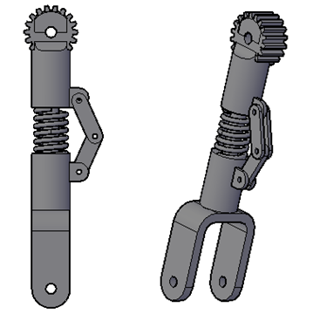
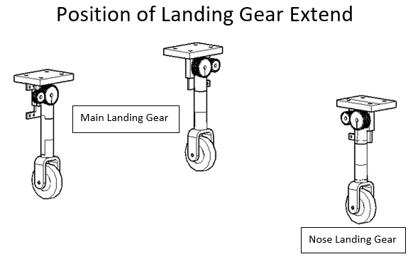
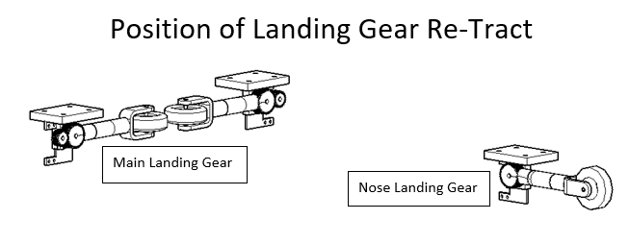
Landing Gear Design

Slide 11
Landing Gear Drawing Engineering

Slide 12
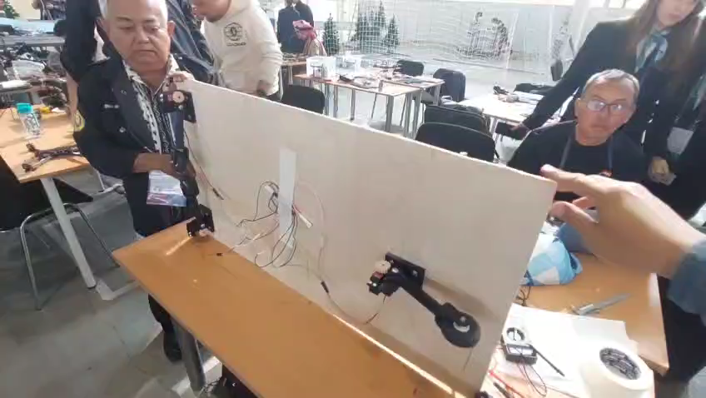

Slide 13
Thank you for your attention

